Slide 1
Transparency – Intermediate – Module 3
Lesson 2 – CESIUM Product Demonstration

Slide 2
Lesson 2

Slide 3

Case study: CESIUM
CESIUM is a tool used by safeguarding professionals to help combat child exploitation
CESIUM allows the user to explore the key aspects of vulnerability for a child through data visualisations and insights from various models to support professional decision making
CESIUM augments professional judgement with evidence-based insights for safeguarding decision-making
Notes:
Brief demo – emphasise the value and importance of co-design within explainability

Slide 4
CESIUM: Explainability Requirements
Who?
Safeguarding professionals at Lincolnshire police and children's social care. Intelligent and engaged. No technical background. Familiar with percentiles, quantifying risk via numbers or colours. Not familiar with machine learning algorithms, histograms
What?
End users are very familiar with the dataset
Technical details of the model not necessary
Need to know why is an individual insight is important
How?
Prioritise and review cases of potential child exploitation risk
Help guide which children might be important cases to review
Support a case review of an individual by providing insights and reasoning
Users have very limited time

Slide 5
CESIUM: DEMO
Notes:
CESIUM demo on insights page – shap feature importance
Demo a person with a high score and explore why, etc

Slide 6
Exercise 1: presenting the result
Firstly, we need to state what question the model trying to answer and what is the result
Suppose John Smith has a model output of 0.78 (which is the 95th percentile)
Discuss the relative merits of the following presentation of this result
John Smith has a model output of 0.78
The likelihood for John Smith to be involved in a MACE meeting is 0.78
John Smith is in the top 5% of children for referral to MACE
John Smith is in the 95th percentile of children for referral to MACE
How likely is John Smith to be involved in a MACE meeting at this time?

Slide 7
Exercise 1: Discussion points
Using the phrase ‘model output’ does not contextualise the result for the end user
Using the output of the model does not provide a comparison of the result compared to other people that the police need to prioritise against.
The end user is interested in which children they should focus their time and resources on, as such as score relative to other children would be more beneficial to their operations. Does the model output have any operational value in isolation?
Does the end user understand the concept of a percentile? Answer in this case – yes
It is useful for big numbers to mean higher risk.

Slide 8
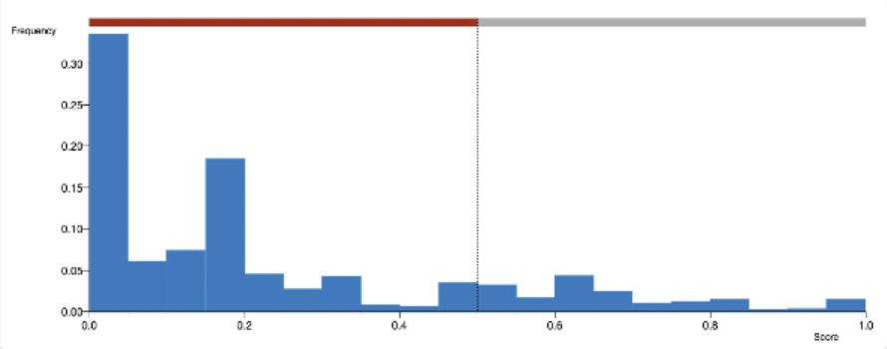
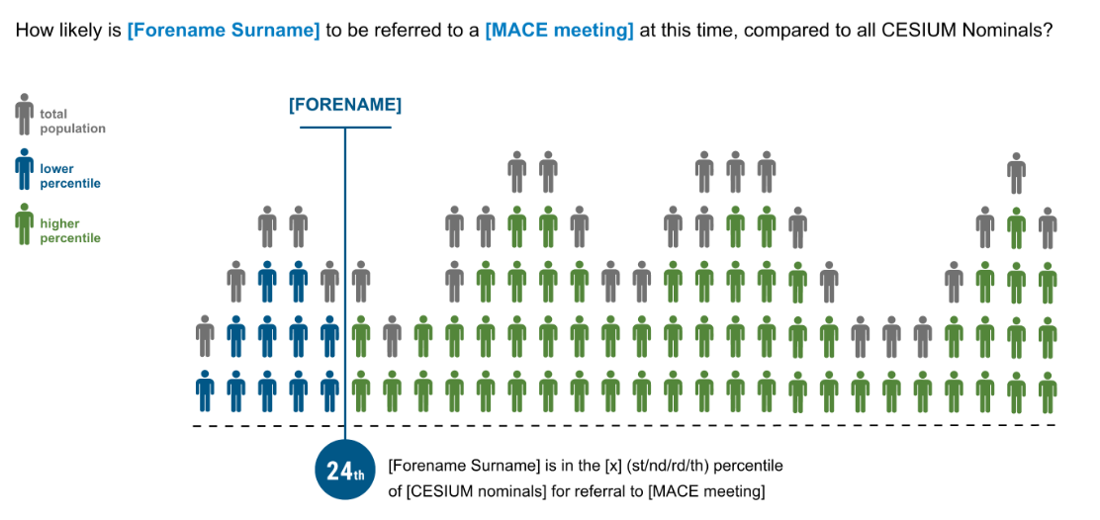
Exercise 2: visualising the result
Gives a multi-model approach to the explainability and allows end users to understand the result in different ways
Providing a visualisation helps to make it obvious that we are comparing an individual's score to all other children and the result corresponds to their position
Discuss the relative merits of the two different designs of visualisation

Slide 9
Exercise 2: discussion points
End users not comfortable with histograms
Pictograms are more common in everyday life
Pictogram connects the fact that the area represents people
Colour helps clarify the point
Statement on the visualisation helps make the point

Slide 10
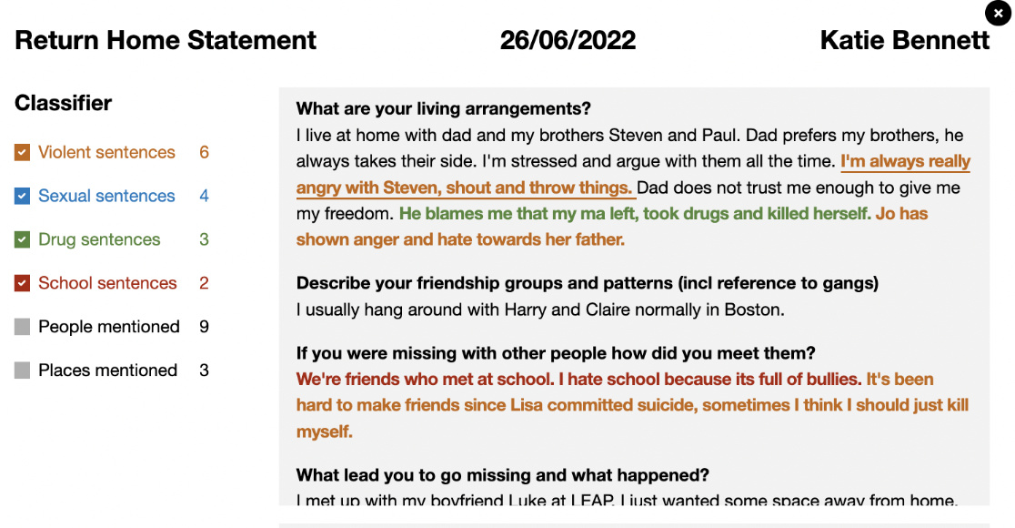
Exercise 3: why was a sentence flagged
Aim: identify text containing potential sexual and violent content to make it easier and quicker for the reader to identify vulnerability to the child
Discuss the relative merits of explaining the results of these text classifiers using
visual explainability (a bar chart to give relative importance of each word)
textual explainability (a sentence listing the 3 most important classifying words in the sentence).
Notes:
Possible discussion points:
Bar chart has more detail – it is a more complete explanation
As we discussed before, it is not about giving the most amount of explanation, but giving it at the right level
Textual explanation is much more intuitive and easier to understand
A bar chart for each sentence can be confusing and overwhelming
Textual explanation provides the most important information succinctly
Textual explanation does not give the whole picture

Slide 11
Exercise 3: discussion points
Bar chart has more detail – it is a more complete explanation
As we discussed before, it is not about giving the most amount of explanation, but giving it at the right level
Textual explanation is much more intuitive and easier to understand
A bar chart for each sentence can be confusing and overwhelming
Textual explanation provides the most important information succinctly
Textual explanation does not give the whole picture

Slide 12
Thank you!

